Slide 1

Warehouse Simulator
By Daulton Nelson
Genre: Logistics / Simulation

Slide 2
”Walk up, box up, ship out!”
Warehouse Simulator is a simulation game about the logistics of working in a shipment warehouse. Players/Users will travel around a virtual warehouse in the position of an “order picker” where they'll have to find orders displayed on the screen, then collect those orders to then be shipped out to customers. Warehouse Simulator will utilize realistic work practices of warehouse associates in order to simulate the sensation of building up a cart of orders without having to go through the physical labour involved.

Slide 3
Mechanics (Part 1)
There are several mechanics to Warehouse Simulator listed below in categories and sub-categories.
Movement
--Walk around with WASD
--Drag along a cart of boxes
--[Potential] Automatic Camera System
Order Collection (Part 1)
--Triggers to tell when the player is in the correct location
--Number buttons to pick the self space to pick from
--Error Checking to make sure player is picking right order

Slide 4
Mechanics (Part 2)
There are several mechanics to Warehouse Simulator listed below in categories and sub-categories.
Order Collection (Part 2)
--Order is taken from shelf and put into player inventory
--A timer for the player to tell them how long it's taken them to get current order
--A List of Orders to collect that is sorted by Warehouse layout
Order Collection (Part 3)
--A process to check when the player has picked all orders to bring it to shipping
--Shipping turn in

Slide 5
Mechanics (Part 3)
There are several mechanics to Warehouse Simulator listed below in categories and sub-categories.
Warehouse Layout (Part 1)
--Floor space will several shelf types
--Some shelves have multiple levels to be picked from
--All shelves have some sort of identification that make them easy to find for player
--Shipping Section
Warehouse Layout (Part 2)
--Player cart pick up
--Space between shelves for player to walk easily

Slide 6
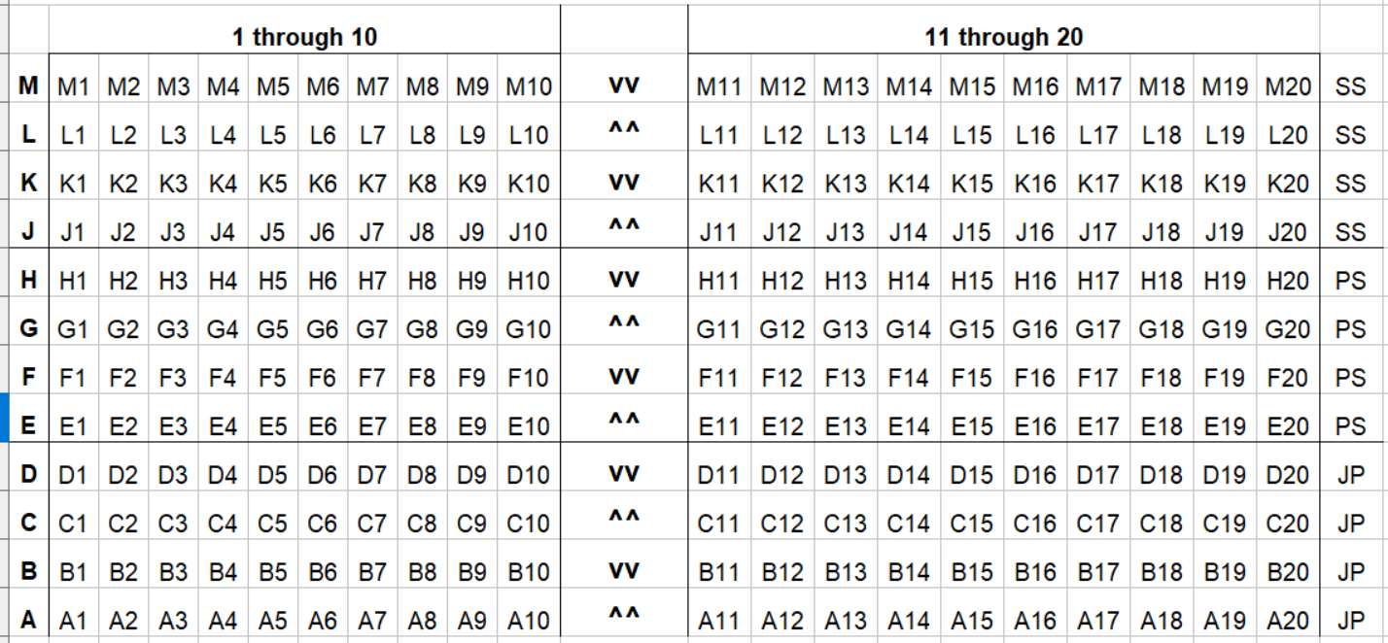
Visualizations
Shelves Layout
(Pallet Shelves/Short Selves/Pallets)

Slide 7
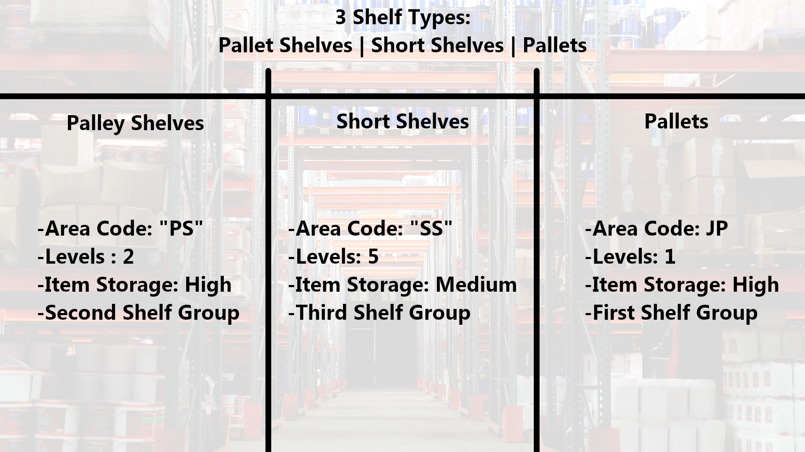
Visualizations
Shelves Breakdown

Slide 8
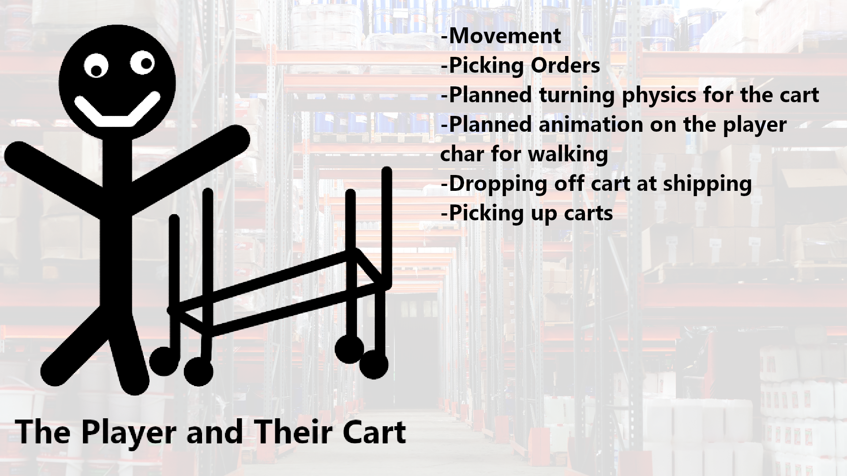
Visualizations
Player Cart

Slide 9
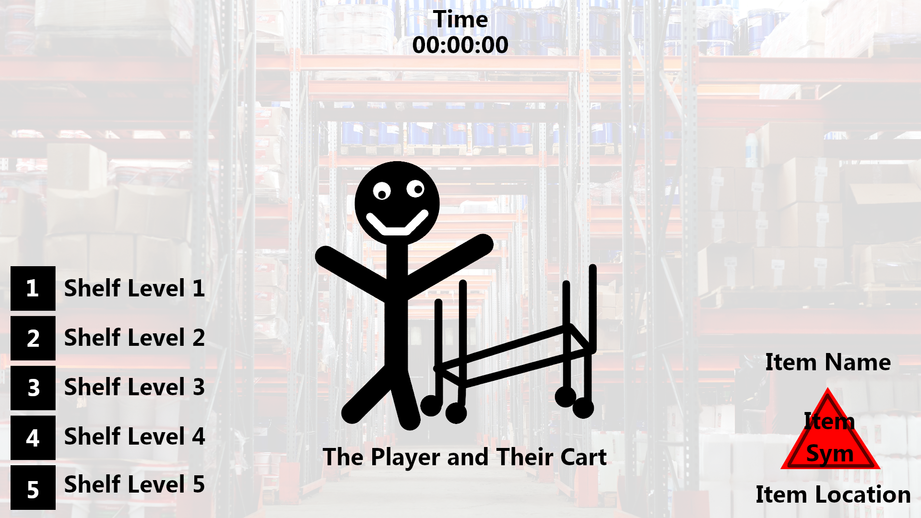
Visualizations
Interface

Slide 10

Staff and Resources
Game Development
--Unity Engine
2D Asset Creation
--GIMP
3D Asset Creation
--Blender
Git / Project Manager
--GitHub
Daulton Nelson
Developer / Programmer / Planner

Slide 11
Target Audience
>= 18 yr. United States Citizens
Potential Warehouse Workers
Logistics Interested
Strategy Players
Corporate Warehouse Business looking to buy training software
PC Players

Slide 12
Timeline
Start Date – 11/4
Plan Visual – 4th or 5th
Movement - 6th
Start on Warehouse Layout - 6th or 7th
Start on Order Collection - 7th or 8th
Projected End Date – 11/26 (4 Week Project)

